Slide 1

Welcome Parents
Back to School Night
2021 - 2022
Jackson Liberty High School

Slide 2
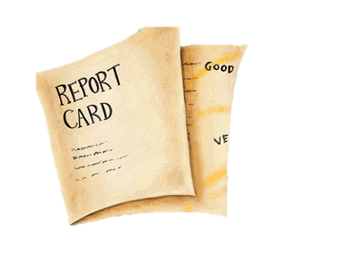

Class Procedures
Every lesson will begin with “warm up” problems. Students are expected to come to class and begin working on it immediately.
Before beginning the days lesson, homework will be checked in and any questions the students may have will be answered.
Homework must have all work shown in order to get credit.
Late homework is only accepted the day after it is due and it is only given half credit. After that, the zero stands.

Slide 3
Parent Portal
Genesis is our online grading and communication system: parent portal
Grades are updated weekly and may include assignment descriptions and comments
I encourage both students and parents to use Genesis portal to view upcoming assignments and personal comments at least weekly
Great way to stay informed!

Slide 4

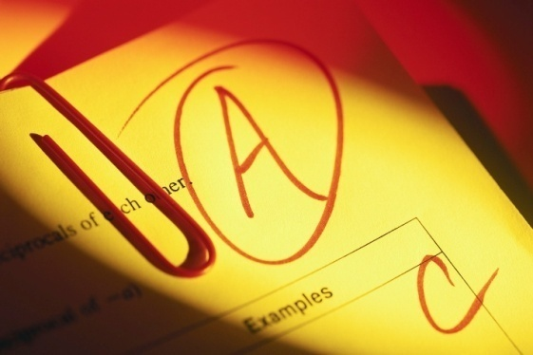

Grading:
20% Homework
20% Participation/ Class Work
60% Assessments
Honors/AP Courses
15% Homework
15% Participation/Class Work
70% Assessments

Slide 5
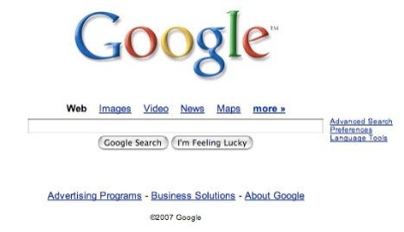
Google Classroom
Each class has their own google classroom. I will be adding notes, homework and useful links daily. It is a great way to keep current especially if you have to be absent.
Syllabus
Notes, Examples and Homework Assignments
Class and School Announcements
Links and additional Resources
Extra Credit Assignments (possibly)

Slide 6


Extra Help Opportunities
I am available to offer extra help, clarification of assignments, and study help for quizzes/test to students:
Monday - Thursday
After school until 2:00

Slide 7


Contact Information
Email:
Mrs. Caruso: aecaruso@jacksonsd.org

Slide 8
Thank You so much for coming tonight
I anticipate a great school year!
Feel free to contact me with any concerns or questions

